Slide 1
MOVIE RECOMMENDATION SYSTEM BEA30.Kshiteeja BEA70.Ajinkya BEA69.Jyoti

Slide 3
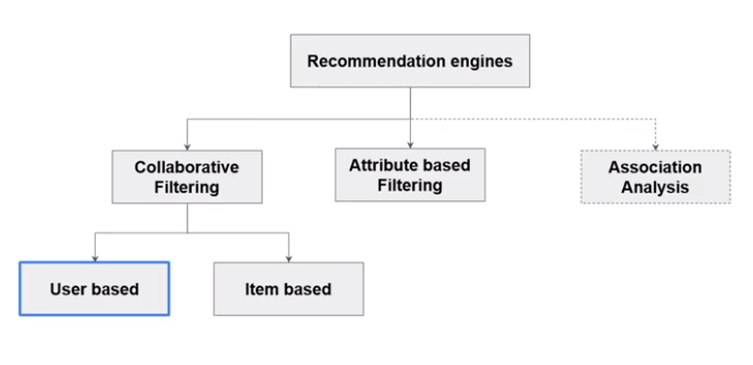
COLLABRATIVE FILTERING

Slide 4
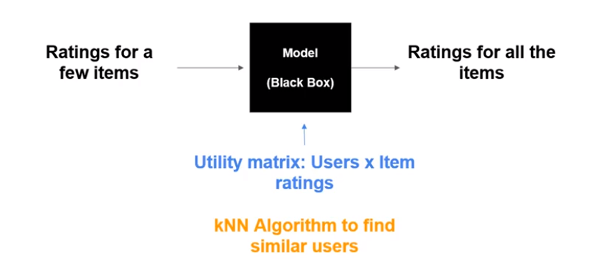

Slide 5
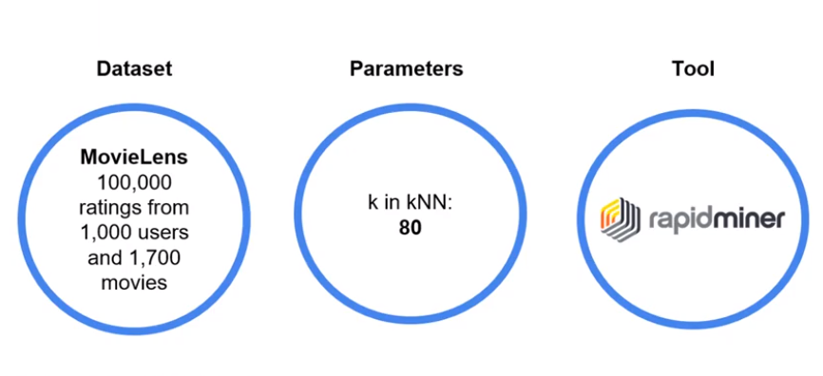
MODEL PLAN

Slide 6
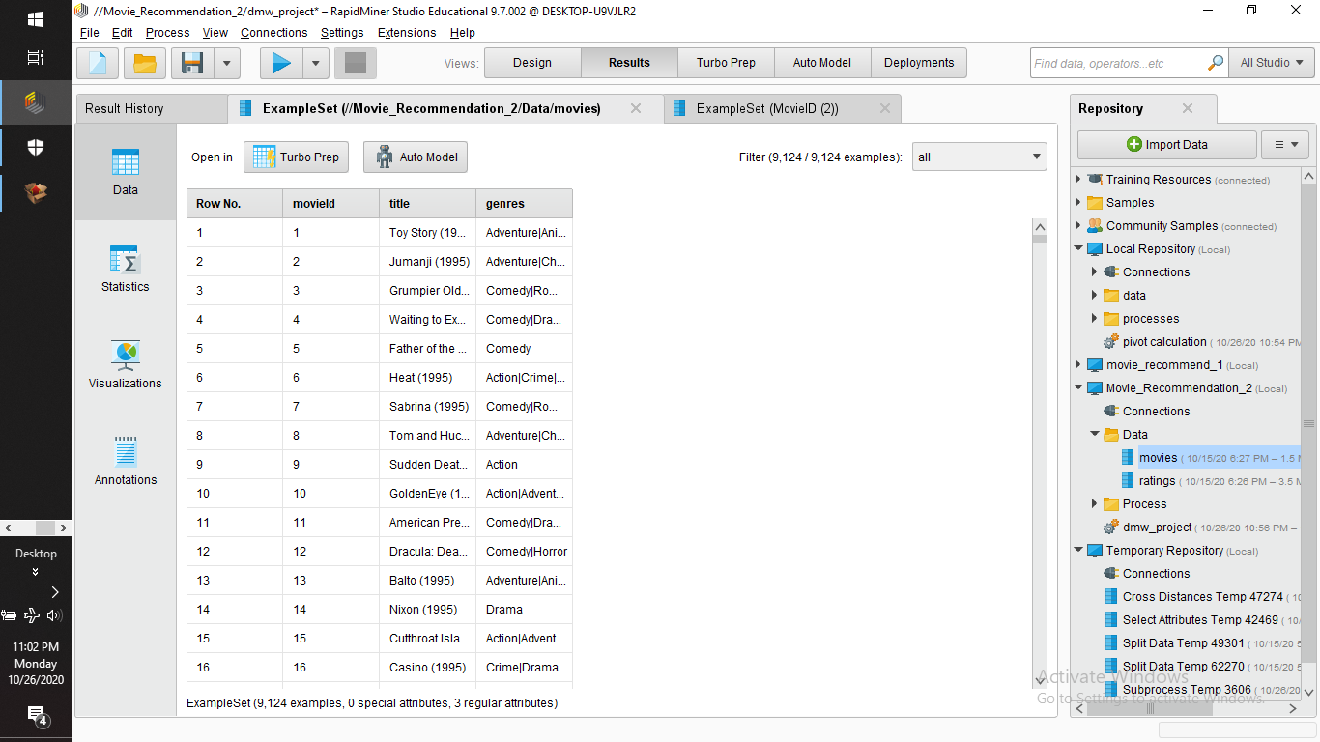
MOVIE DATASET

Slide 7
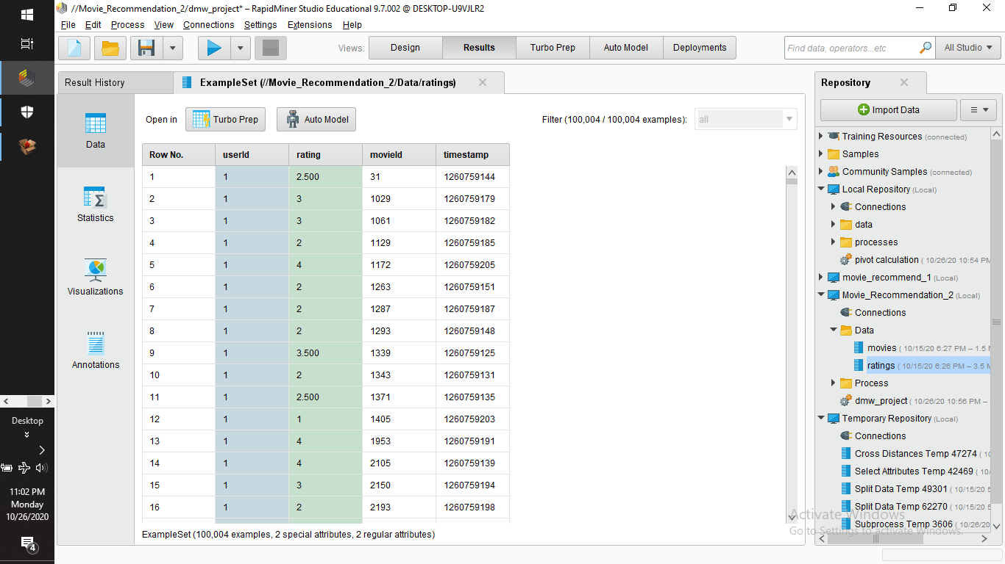
RATING DATASET

Slide 8
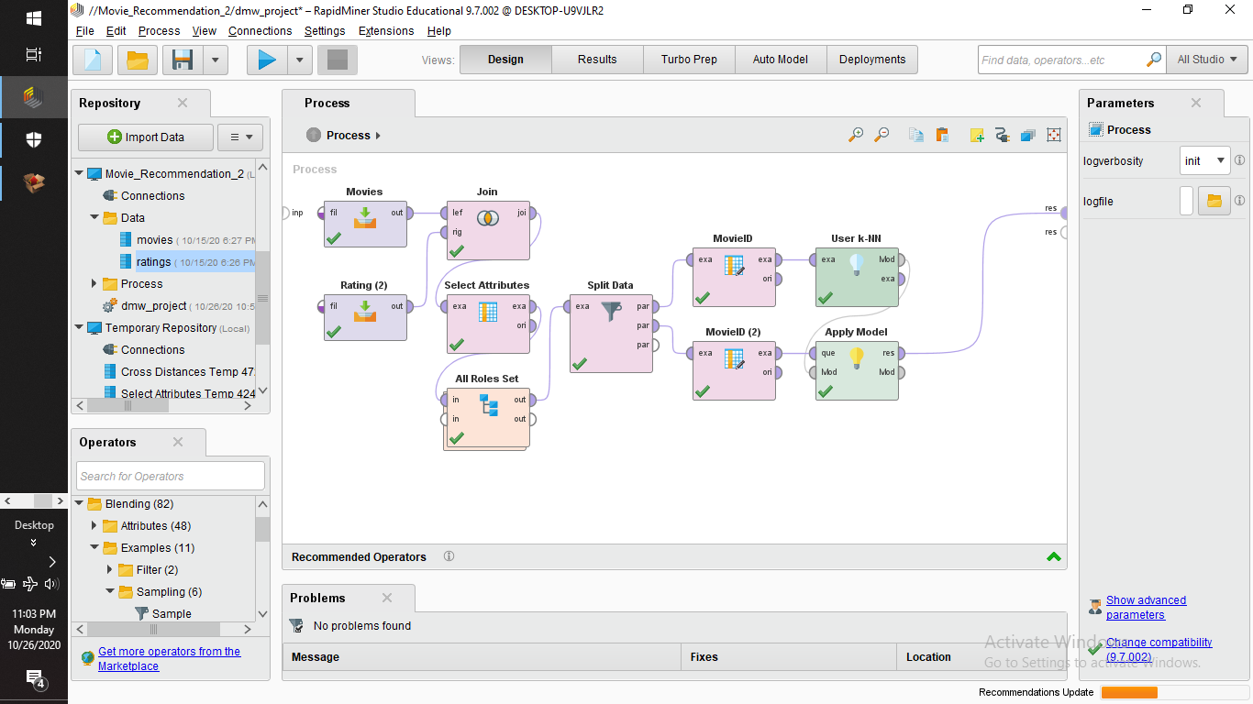
PROCESS

Slide 9
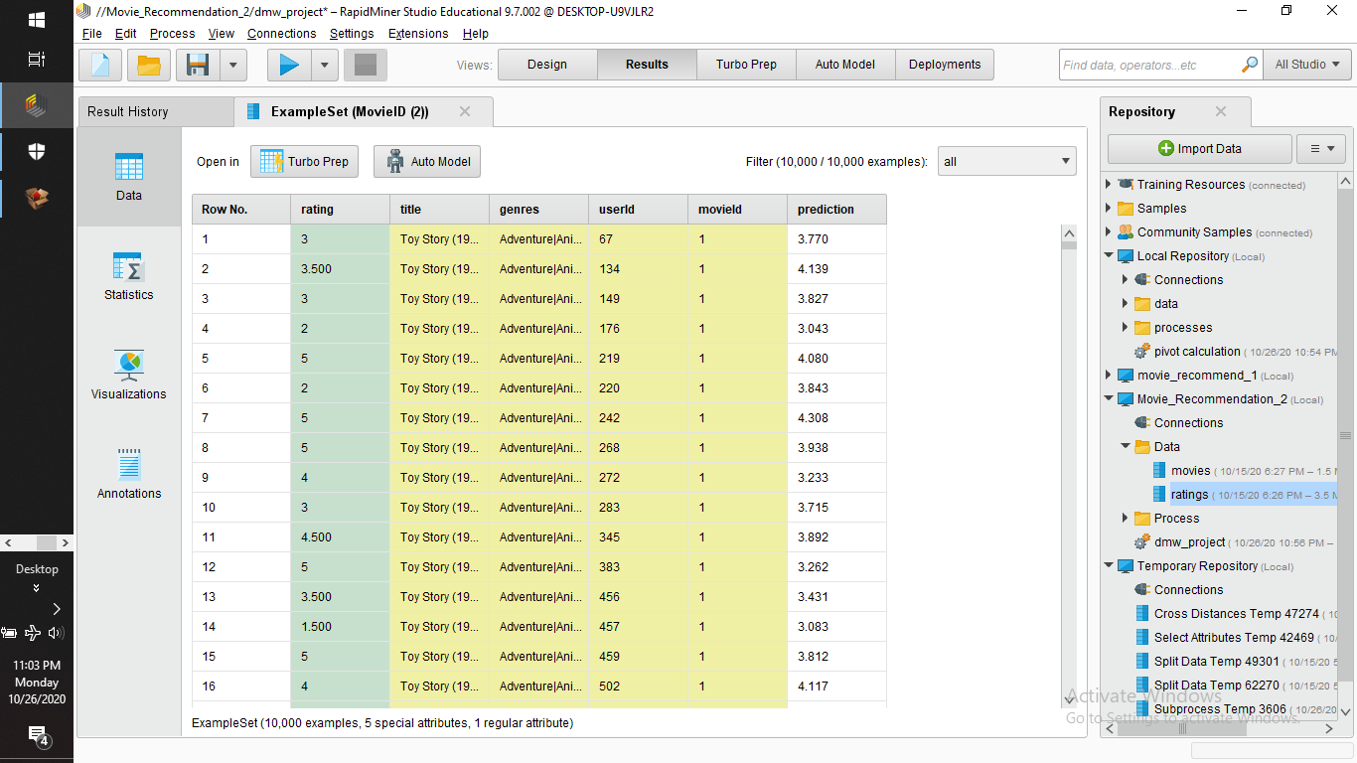
PROCESS OUTPUT

Slide 10
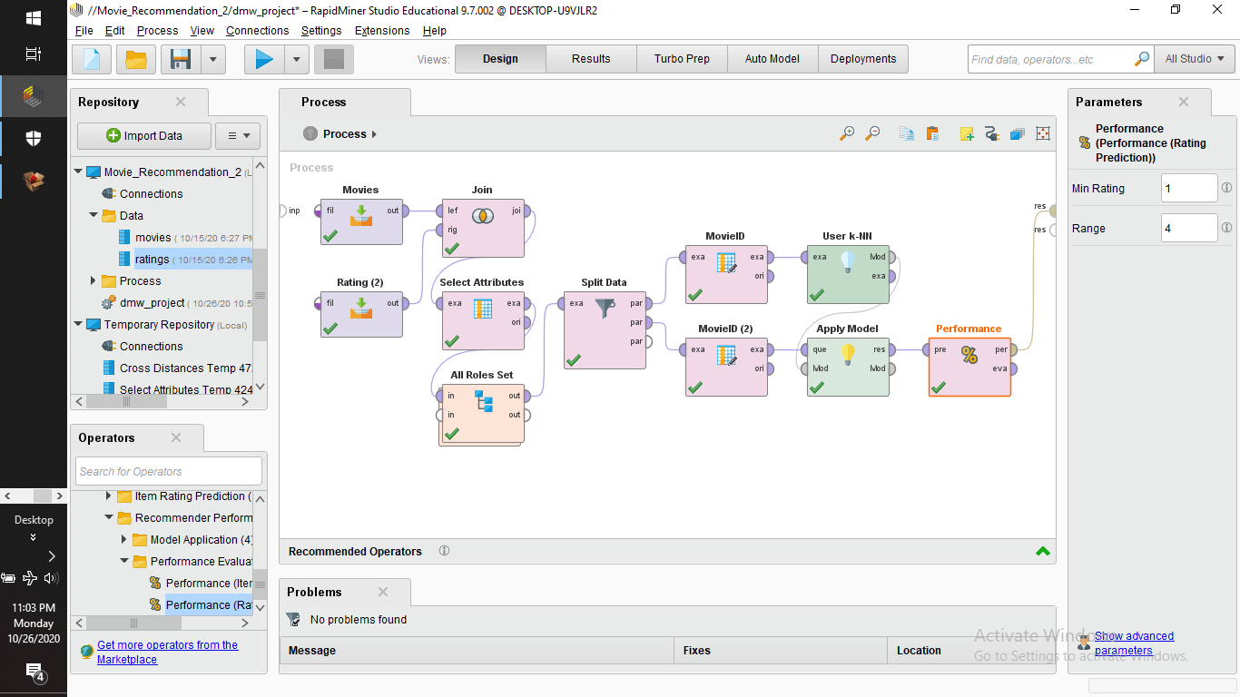
PERFORMANCE

Slide 11
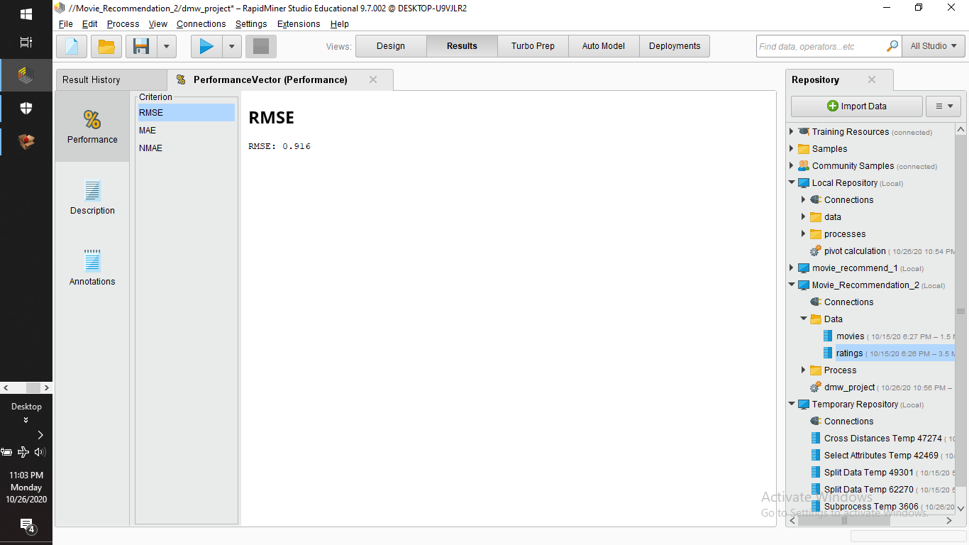
PERFORMANCE OUTPUT

Slide 12
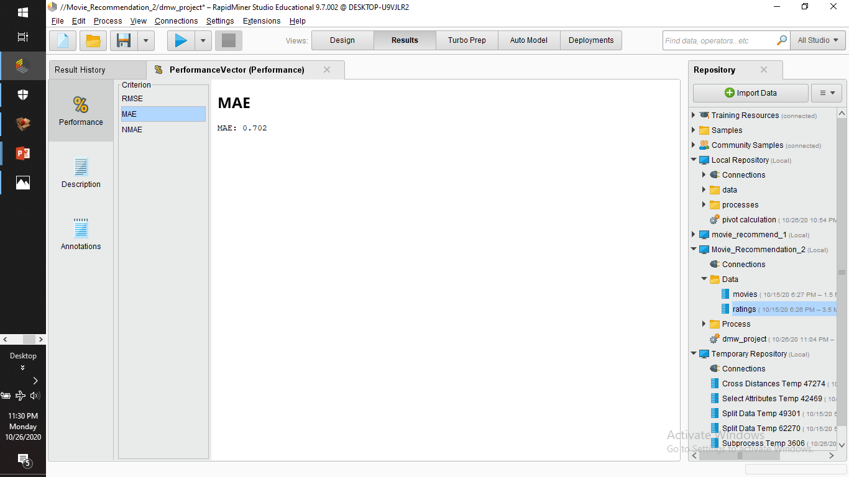
PERFORMANCE OUTPUT

Slide 13
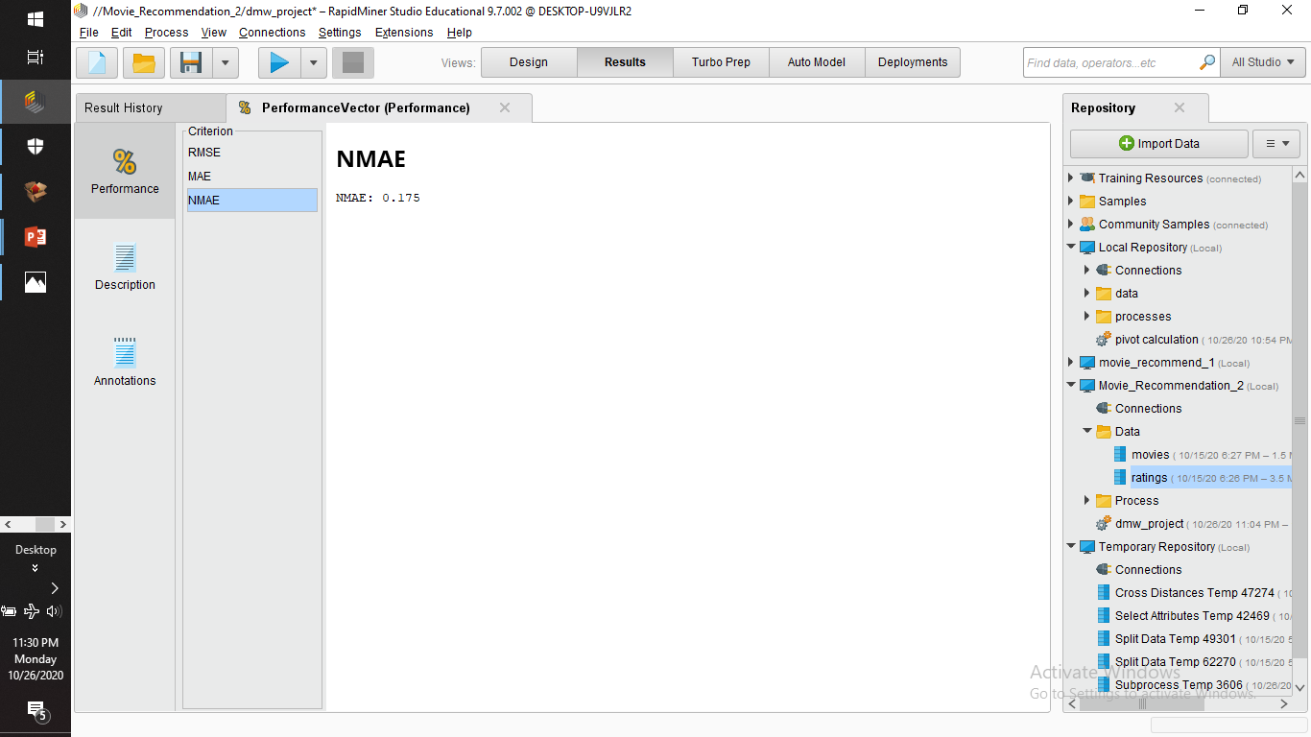
PERFORMANCE OUTPUT

Slide 14
THANK YOU!!!

